Slide 1
The Development of Catholic Trinitarian Theology
Jesus Christ Course
Document #: TX001188

Slide 2
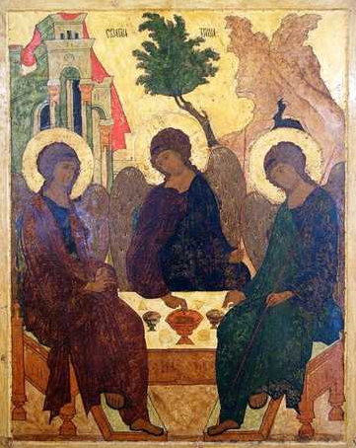
General Overview of Trinitarian Theology
Trinitarian theology developed over time through God’s Revelation and guidance.
The Church clarified the truth of the doctrine through ecumenical councils.
Ecumenical councils are gatherings of the Church’s bishops from around the world, convened by the Pope, to discuss and resolve pressing issues in the Church.
Image in public domain

Slide 3
Context of the Early Church
Early Church communities were widespread around the Roman Empire.
Communication between the early Church communities was limited and challenging.
Many people had their own theories about who Jesus was and what his time on earth achieved.
In some cases, it took years for theological issues to be raised and clarified.
Early ecumenical councils developed the vocabulary and the process to express the depth, breadth, and meaning of sacred truths.

Slide 4
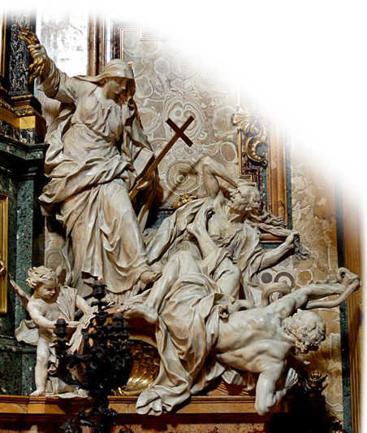
Christological Heresies
During the first several centuries of the Church, some Christological heresies, or incorrect beliefs about Jesus, developed.
Docetism
Gnosticism
Arianism
Nestorianism
Monophysitism
Image in public domain

Slide 5
Christological Heresies
Docetism
The name comes from Greek dokein, meaning “to seem” or “to appear.”
This heretical doctrine said Jesus only appeared to have a human body, so his suffering and death were not real.
Docetism said Jesus is God, but only in disguise.
Docetism denied the fully human qualities of Jesus.
Notes:
Notes: Pause after reviewing this heresy to check for understanding. Allow time for a think-pair-share exercise, or encourage reciprocal teaching to allow the material to be more firmly retained.

Slide 6
Christological Heresies (cont.)
Gnosticism
Name comes from Greek gnosis, meaning “knowledge.”
Gnosticism refers to several religious movements that claimed salvation comes from secret knowledge from God or from God’s secret agent or elite.
Gnosticism first appeared in the second century, but it has continued in various forms to the present day.
Notes:
Notes: Pause after reviewing this heresy to check for understanding. Allow time for a think-pair-share exercise, or encourage reciprocal teaching to allow the material to be more firmly retained.

Slide 7
Christological Heresies (cont.)
Arianism
The name comes from the teachings of Arius (AD 256–336).
This heresy considered Jesus as existing midway between God and creatures.
Arianism denied the eternal existence of the Son of God with God the Father. In other words, it denied Jesus’ divinity, saying he was human like us and did not exist (had no essence) before he was conceived.
Arianism said that Jesus was greater than regular humans, but less than God.
Arianism was declared a heresy at the First Council of Nicaea.
Notes:
Notes: Pause after reviewing this heresy to check for understanding. Allow time for a think-pair-share exercise, or encourage reciprocal teaching to allow the material to be more firmly retained.

Slide 8
Christological Heresies (cont.)
Nestorianism
Name comes from the teachings of Nestorius (AD 386–451), patriarch of Constantinople.
Heresy taught that Jesus has two complete natures and is therefore two persons: one divine and one human.
This also meant that Mary was the Mother of Jesus but not the Mother of God.
Nestorianism was rejected by the Council of Ephesus in 431. The Council taught that human and divine nature are united in the one person of Christ.
Notes:
Notes: Pause after reviewing this heresy to check for understanding. Allow time for a think-pair-share exercise, or encourage reciprocal teaching to allow the material to be more firmly retained.

Slide 9
Christological Heresies (cont.)
Monophysitism
The name comes from the Greek monastikos, meaning “single,” and physis, meaning “nature.”
The name refers to the position that Christ has only a single divine nature.
This heresy believed that Jesus’ divinity fully absorbed his humanity, so that in the end he is only divine and not human.
Monophysitism was rejected by the Council of Chalcedon in AD 451. The Council taught that Christ has a human and a divine nature.
Notes:
Notes: Pause after reviewing this heresy to check for understanding. Allow time for a think-pair-share exercise, or encourage reciprocal teaching to allow the material to be more firmly retained.

Slide 10
Overview of Ecumenical Councils
Between AD 325 and 787, seven ecumenical councils were held to define Christological and Trinitarian doctrines:
First Council of Nicaea (AD 325)
First Council of Constantinople (AD 381)
Council of Ephesus (AD 431)
Council of Chalcedon (AD 451)
Second Council of Constantinople (AD 553)
Third Council of Constantinople (AD 680)
Second Council of Nicaea (AD 787)
The two most important, Nicaea and Chalcedon, took place in what is now modern-day Turkey.

Slide 11
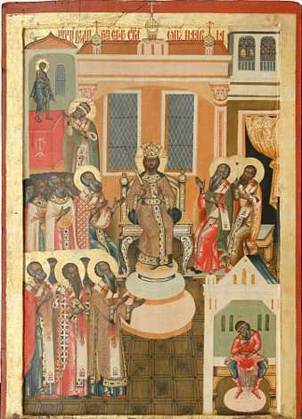
The First Council of Nicaea, AD 325
This is one of the most significant councils.
It declared that Jesus is truly God.
It declared that God the Son is “of the same substance as” (“consubstantial with”) God the Father.
It countered Arianism.
“Eternally begotten of the Father, God from God, light from light, true God from true God.” —Original Nicene Creed, written in AD 325
Image in public domain

Slide 12
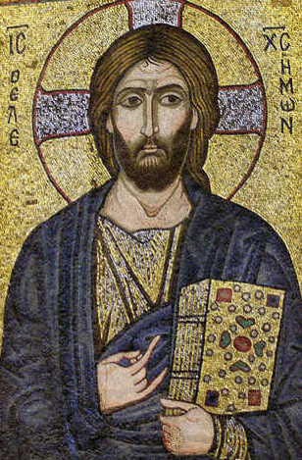
The Council of Chalcedon, AD 451
It focused on God the Son.
Attended by 350 bishops.
It declared that Jesus has two natures: human and divine, undivided and inseparable.
Jesus is 100 percent human and 100 percent divine.
Jesus is not half human and half divine, nor two persons pushed into one.
Jesus, God the Son, is one Divine Person.
Image in public domain

