Slide 1
Wisdom Literature
The Living Word: The Revelation of God’s Love, Second Edition
Unit 3, Chapter 11
Document#: TX004689

Slide 2
Universal Truth
The wisdom books focus on everyday life.
They support our quest to glean wisdom from human emotion and struggle.
God, the source of wisdom, is at the center of all our human experience.
© Monkey Business Images / Shutterstock.com
Notes:
Notes: Ask the students how the wisdom literature is different from other books in the Old Testament. (These books do not focus on Israel’s history or Law.)
This slide corresponds to content in the chapter 11 introduction in the student book.

Slide 3
Job
The Book of Job asks, Why do good people suffer and wicked people prosper?
Job, a good man, endures the loss of family, land, home, and health.
A core belief of the time was that God rewards the righteous and punishes the unjust.
© ihartcreations / iSockphoto.com
Notes:
Notes: Ask the students this question: How would you answer if a friend asked why good people suffer and wicked people prosper?
This slide corresponds to content in article 51, “Job: Understanding Suffering,” in the student book.

Slide 4
God Does Not Cause Suffering
God has allowed Satan to test Job through a series of losses.
God has not directly caused Job’s suffering.
God knows that Job can withstand any trial because of his deep faith.
© Monkey Business Images / Shutterstock.com
Notes:
Notes: Review with the students the outline of the plot of the Book of Job, as described in article 51 in the student book.
This slide corresponds to content in article 51, “Job: Understanding Suffering,” in the student book.

Slide 5
Lessons Learned from Job
Suffering is not a punishment for sin.
God does not want his people to suffer.
Patience in our sufferings leads to growth in our relationship with God.
God deserves our love even when life takes a turn for the worse.
© abd / Shutterstock.com
Notes:
Notes: Discuss with the students the difference between questioning God and withholding love and respect for God. Ask for examples from daily life in which we may question the decisions of others while still loving or respecting them.
This slide corresponds to content in article 51, “Job: Understanding Suffering,” in the student book.

Slide 6
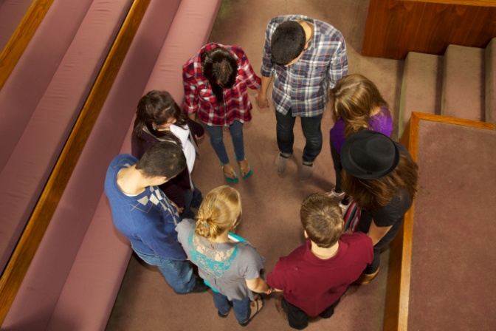
The Psalms
The Psalms reflect the joys and sorrows of Israel’s journey of faith.
The Hebrew title of the book means “praises” or “hymns of praise to God.”
The collection of 150 psalms is also known as the Psalter.
© pastorscott / iStockphoto.com
Notes:
Notes: Explain to the students that many Catholics pray the Psalms regularly because they express a wide range of responses to God’s presence in our lives. Ask the students about their own experiences of praying the Psalms.
This slide corresponds to content in article 52, “The Psalms: Learning to Pray,” in the student book.

Slide 7
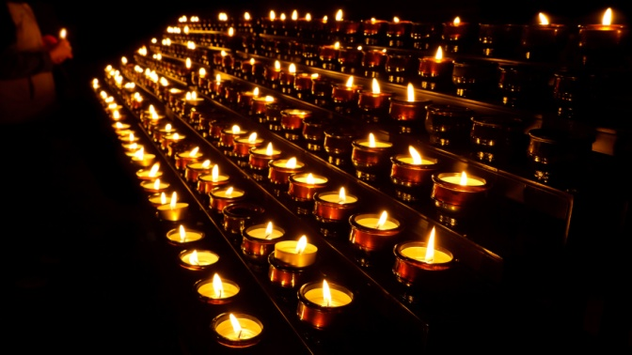
Types of Psalms
A lament is a cry for God’s intervention in difficult situations.
People composed hymns of thanksgiving to thank God for his amazing action in their lives.
Hymns of praise extol God as Creator of the earth and author of history.
© Patrick Poendl / Shutterstock.com
Notes:
Notes: Ask the students what type of prayer they most often pray: lament, thanksgiving, or praise. Discuss the value of each type of prayer.
This slide corresponds to content in article 52, “The Psalms: Learning to Pray,” in the student book.

Slide 8
Mirror of the Soul
The emotions contained in the Psalms mirror universal human experience.
The Psalms were central to the teachings and prayers of Jesus.
The Psalms express our inner longing for God, so that we too can be a people of prayer.
© Tracy Whiteside / Shutterstock.com
Notes:
Notes: Ask the questions at the end of article 52 in the student book: How do the Psalms and other well-known prayers help to ground us in the past? Why is it important to recall our past when we pray? Consider sharing your own answers to these questions.
This slide corresponds to content in article 52, “The Psalms: Learning to Pray,” in the student book.

Slide 9
Ecclesiastes
The Book of Ecclesiastes reflects the Teacher’s search for meaning.
Though wise, he realizes there is much more he does not understand about life and God.
© Lucky Business / Shutterstock.com
Notes:
Note: Discuss with the students the quotation from Ecclesiastes 3:1–8 at the beginning of article 53 in the student book, and ask these questions: Why might sorrow accompany wisdom? What specific examples can you think of?
This slide corresponds to content in article 53, “Ecclesiastes: The Ongoing Search for Meaning,” in the student book.

Slide 10
A Time for Everything
The Teacher proclaims that God’s ways are not our ways, nor is his timeline ours.
The closer we come to God, the more we become willing to trust in his care.
© Dream Perfection / Shutterstock.com
Notes:
Notes: Discuss with the students how we can get through times when God’s plans don’t agree with our plans (e.g., by turning to friends, prayer, etc.).
This slide corresponds to content in article 53, “Ecclesiastes: The Ongoing Search for Meaning,” in the student book.

Slide 11
Carpe Diem: Seize the Day
The author of Ecclesiastes teaches that earthly life lacks permanence.
We should live every day with energy and joy.
Our wisdom may be limited, but it guides our searching hearts toward God.
© Tom Lester / Shutterstock.com
Notes:
Notes: Ask the students about the myth that Christians or Catholics can’t have any fun. Lead a discussion about being able to “seize the day” while still remaining faithful to God.
This slide corresponds to content in article 53, “Ecclesiastes: The Ongoing Search for Meaning,” in the student book.

Slide 12
Song of Songs
This book (also called the Song of Solomon) is a passionate love song.
It uses poetry with vivid imagery to describe the beauty of love.
© damircudic / iStockphoto.com
Notes:
Notes: Explain to the students the allegorical meaning of the Song of Songs, as described in article 54 in the student book.
This slide corresponds to content in article 54, “Song of Songs: The Beauty of Love,” in the student book.

Slide 13
Ideal Human Love
We long to find true love and affection, but real love cannot be forced.
Love should not be self-seeking.
It finds joy in mutuality, honesty, trust, and sacrifice.
Song of Songs uses bridal imagery to reveal the beauty of love.
© Monkey Business Images / Shutterstock.com
Notes:
Notes: Ask the students this question: Why are mutuality, honesty, trust, and sacrifice all important parts of authentic love? Discuss each term separately.
This slide corresponds to content in article 54, “Song of Songs: The Beauty of Love,” in the student book.

Slide 14
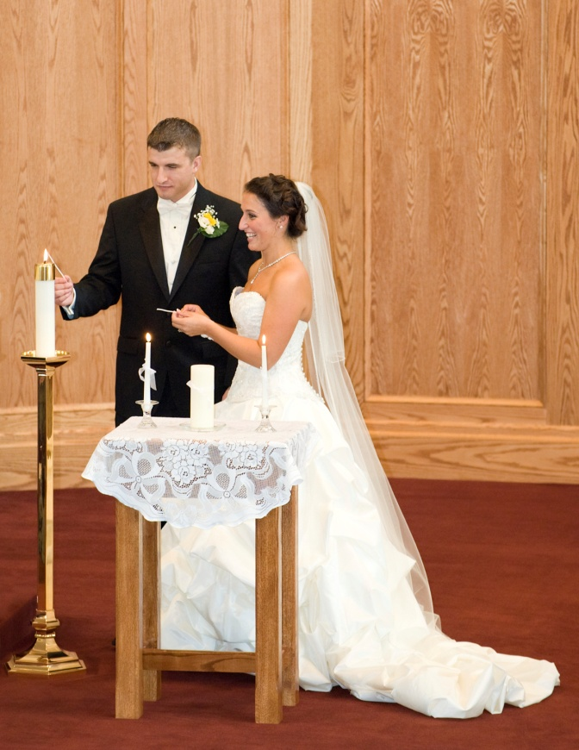
Love between Creator and Creature
Song of Songs is an allegory.
It paints a picture of God as a faithful lover of his beloved people.
God has called his Chosen People, his bride, to a spiritual union of perfect love.
© iStock.com / Shutterstock.com
Notes:
Notes: Explain to the students that Christ is like the bridegroom in Song of Songs: he has formed an unbreakable union with his beloved bride, the Church.
This slide corresponds to content in article 54, “Song of Songs: The Beauty of Love,” in the student book.

Slide 15
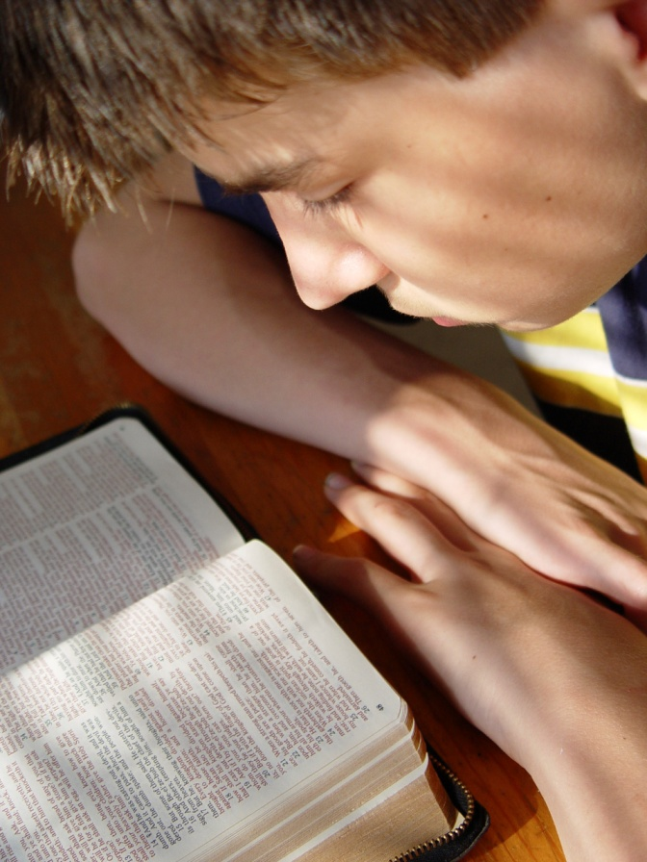
Wisdom
The Book of Wisdom was written when Jews were settling new lands.
It teaches that we must incorporate the wisdom of the past into the present.
© bobbieo / iStockphoto.com
Notes:
Notes: Ask the students for examples from their own lives that demonstrate the value of holding onto wisdom from the past.
This slide corresponds to content in article 55, “Wisdom: Seeking Truth,” in the student book.

Slide 16
Wisdom Personified
Personification uses human characteristics to describe something that is abstract.
In the Book of Wisdom, wisdom is personified as a female.
The ultimate embodiment of God’s wisdom is Jesus Christ.
© michaeljung / Shutterstock.com
Notes:
Notes: Ask the students to describe someone in their life who might come close to a personification of wisdom.
This slide corresponds to content in article 55, “Wisdom: Seeking Truth,” in the student book.

Slide 17
Teacher, Counselor, and Preserver
In the Book of Wisdom, we learn that wisdom instructs us in the ways of God.
Wisdom reminds the people that God is both Creator and rescuer.
© TanawatPontchour / iStockphoto.com
Notes:
Notes: List some of the characteristics of wisdom shared in article 55 in the student book.
This slide corresponds to content in article 55, “Wisdom: Seeking Truth,” in the student book.

Slide 18
Two More Voices on Wisdom
The Book of Proverbs collects poems and wise sayings from throughout Israelite history.
The Wisdom of Ben Sira praises the wisdom revealed in the heroes of Jewish faith.
© auremar / Shutterstock.com
Notes:
Notes: Review the list of wisdom books in the chapter 11 introduction in the student book.
This slide corresponds to content in article 56, “Two More Voices on Wisdom,” in the student book.

