Slide 1
Jesus Reveals Our Inherent Dignity
Jesus Christ: God’s Love Made Visible, Second Edition Unit 4, Chapter 10
Document#: TX004815

Slide 2
We Are Created as Good
We are good because we are created in the image and likeness of God.
If humanity were not good, God would never have become man.
We are created as good but are in constant need of redemptive grace.
© JLBarranco / iStockphoto.com
Notes:
Ask for examples from recent news reports of human behavior that is hurtful to others or harmful to our world. Explain that human beings are created as good but are in need of salvation.
This slide corresponds to content in article 45, “Created, Redeemed, and Bound for Glory,” in the student book.

Slide 3
In Need of Redemption
Original Sin makes it hard for us to say no to temptation.
It inclines us to act for our own selfish pleasures.
It is through the Sacrament of Baptism that we first gain access to God’s grace.
© Blue_Cutler / iStockphoto.com
Notes:
Review the roots of Original Sin in the Fall, and remind the students that the doctrine does not mean that we are born with personal guilt or that babies commit sins.
This slide corresponds to content in article 45, “Created, Redeemed, and Bound for Glory,” in the student book.

Slide 4
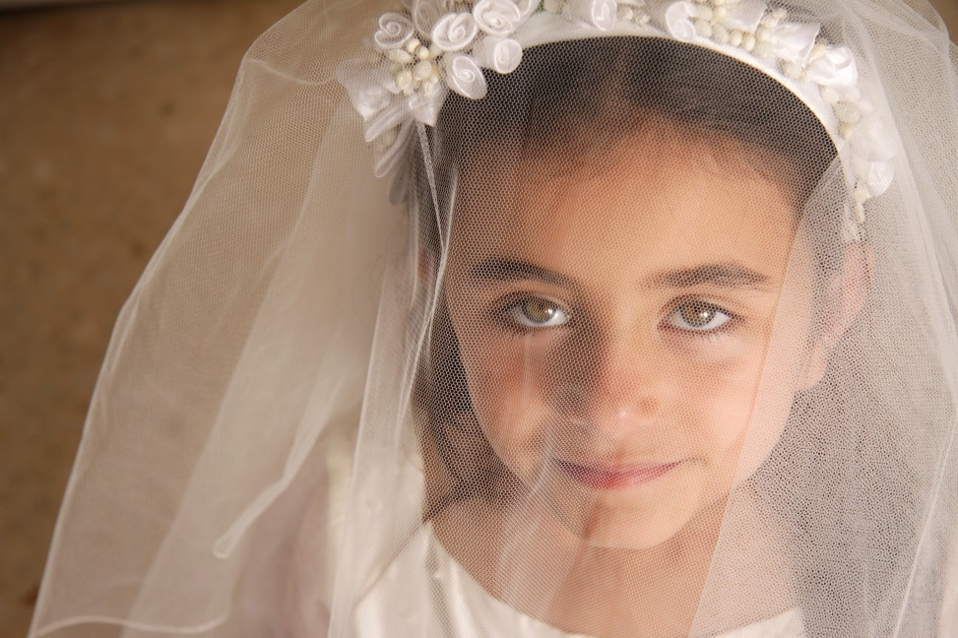
Bound for Glory
Our ultimate destiny is eternal life in the glory of God’s holy presence.
The sacramental life of the Church enables us to find our ultimate destiny.
The Sacraments strengthen us on the journey and reinforce our identity.
© AnneMS / Shutterstock.com
Notes:
Discuss the concept that our identity is closely tied to our destiny. Ask how seeing oneself as a person destined to share in eternal glory informs our identity.
This slide corresponds to content in article 45, “Created, Redeemed, and Bound for Glory,” in the student book.

Slide 5
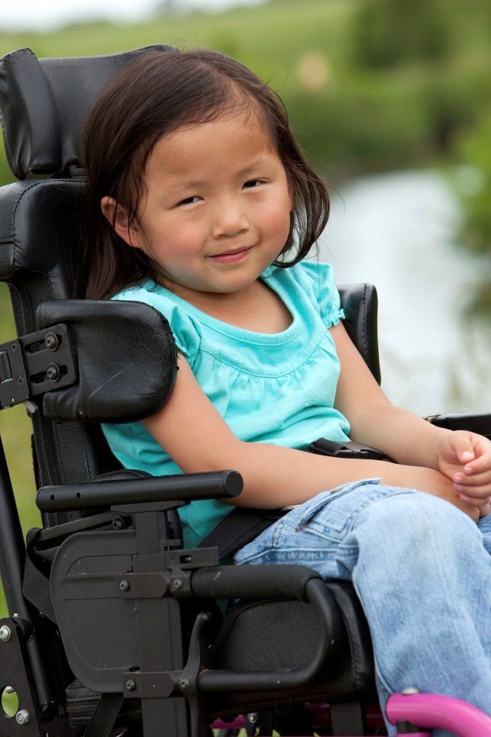
The Inherent Dignity of All People
Only humans are created in God’s divine image.
We have a unique, inherent dignity given to us by God.
Inherent means that this dignity is so much a part of us . . .
. . . that no one can ever take it away.
© jabejon / iStockphoto.com
Notes:
Ask for examples of people whose dignity is not fully recognized in our society. Emphasize that human dignity does not depend on our behavior, the ability to be productive citizens, or whether others care about us.
This slide corresponds to content in article 46, “The Inherent Dignity of All People,” in the student book.

Slide 6
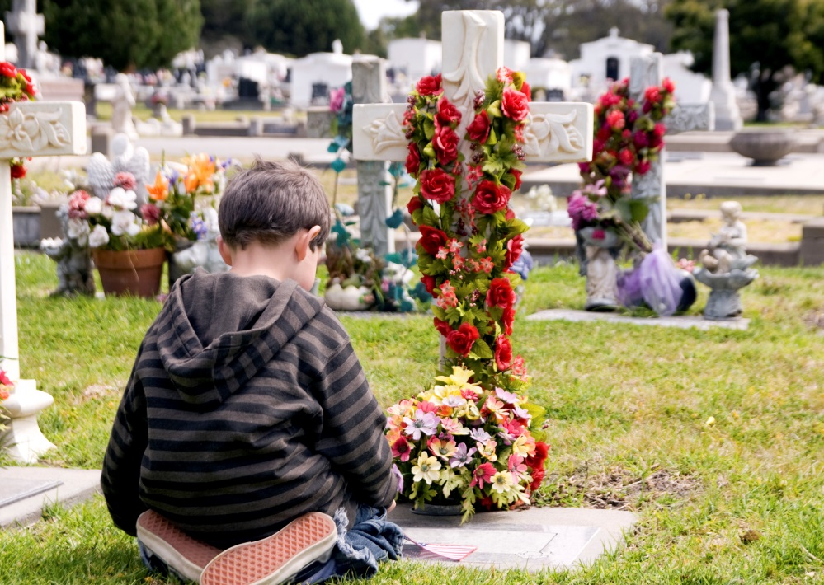
Body and Soul United
Only humans have a spiritual, immortal soul.
Our souls are created directly by God.
While we live on earth, our bodies and souls dwell together as one unified being.
© nicolesy / iStockphoto.com
Notes:
Review what happens to our souls when we die (they are separated from our bodies) and at the final resurrection (our souls will be reunited with our glorified bodies). Read aloud Saint Paul’s explanation in 1 Corinthians 15:35–37,42–44.
This slide corresponds to content in article 46, “The Inherent Dignity of All People,” in the student book.

Slide 7
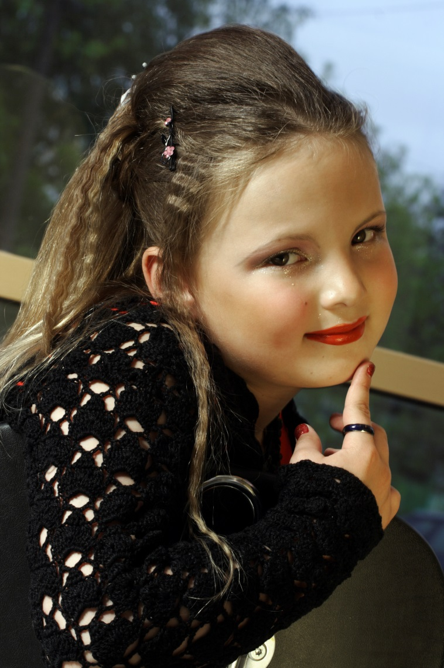
Not Something, but Someone
We must not treat people as objects to suit our own purposes.
Jesus treated every person he met equally, with compassion.
The Church seeks to follow Jesus’ example by protecting the dignity of all.
© oleg66 / iStockphoto.com
Notes:
Ask for examples of how people use others. You may wish to open with, “Of course people can use others sexually; what are some other ways people use others for their own purposes?” (For example, take credit for others’ work to earn rewards, befriend others only because they are popular or wealthy, treat workers unfairly to make money, and so on.) Discuss the Live It! sidebar in article 46 of the student book.
This slide corresponds to content in article 46, “The Inherent Dignity of All People,” in the student book.

Slide 8
Jesus: Restoring What We Lost to Sin
Because of Original Sin, the image of God is no longer clear in us.
Jesus is both perfect God and perfect man.
He restores the image and likeness of God in us.
© RonTech2000 / iStockphoto.com
Notes:
Ask the question at the conclusion of article 47 in the student book, “How would you describe the ‘image of the invisible God’?”
This slide corresponds to content in article 47, “Jesus Restores Our Divine Image,” in the student book.

Slide 9
Women and Men: Partners
Human beings were created by God to be in loving relationships with one another.
Men and women are created in God’s image as equals.
In creating us male and female, God has given us the wonderful gift of sexuality.
© franckreporter / iStockphoto.com
Notes:
Ask a volunteer to read aloud the paragraph beginning “The gift of sexuality, however, also comes with the responsibility to cultivate the virtue of chastity,” in the section “Created with the Gift of Sexuality” in article 48 in the student book. Discuss chastity as sexual integrity.
This slide corresponds to content in article 48, “Women and Men: Partners in God’s Plan,” in the student book.

Slide 10
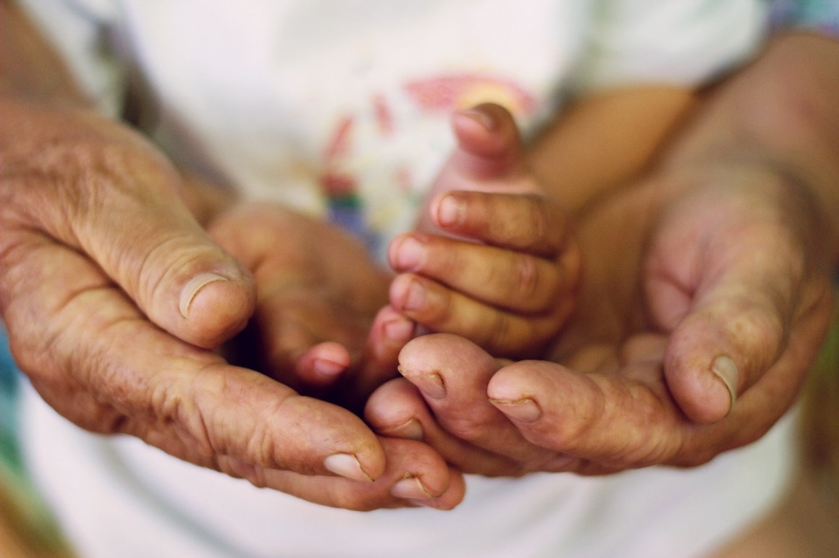
The Inherent Dignity of All Human Life
Jesus revealed that all people have inherent dignity.
Therefore we must respect human life in all its forms.
The consistent ethic of life applies to life in all its stages.
© CebotariN / Shutterstock.com
Notes:
Explain the consistent ethic of life as a comprehensive view that addresses many issues related to the protection of life: abortion, warfare, capital punishment, and even poverty.
This slide corresponds to content in article 49, “The Inherent Dignity of All Human Life,” in the student book.

Slide 11
The Sacred Gift of Life
God is the author and originator of all life.
Only God can decide the time for an individual human life to end.
Altering this course of events violates the Fifth Commandment, “You shall not kill” (Exodus 20:13).
© bibikoff / iStockphoto.com
Notes:
The next slides deal with the beginning and end of life. Remember that some students may have direct experience with life issues related to both time frames.
This slide corresponds to content in article 49, “The Inherent Dignity of All Human Life,” in the student book.

Slide 12
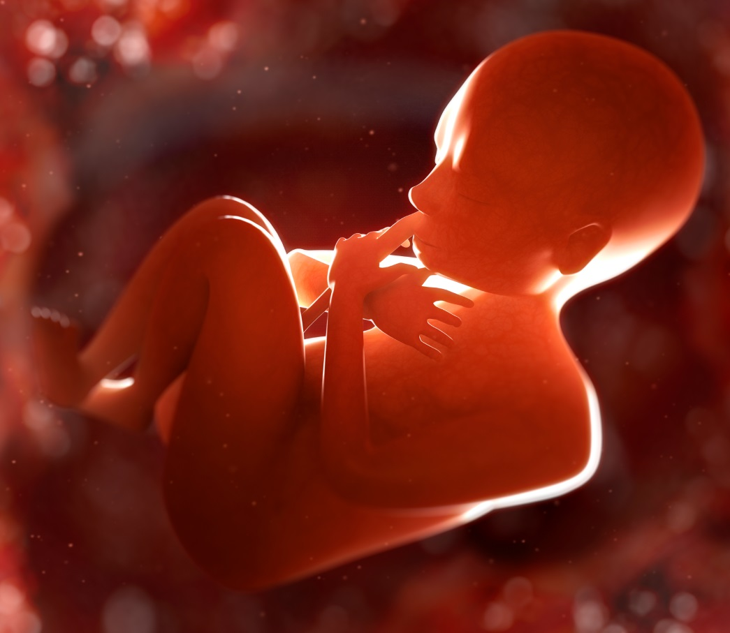
The Beginning of Life
Human life begins at the moment of conception.
For this reason, the Church strongly opposes abortion.
© Henrik5000 / iStockphoto.com
Notes:
Emphasize that abortion is a medical procedure performed for the purpose of ending a pregnancy. Make the students aware of alternatives to abortion and solutions to situations that lead couples to seek abortion.
This slide corresponds to content in article 49, “The Inherent Dignity of All Human Life,” in the student book.

Slide 13
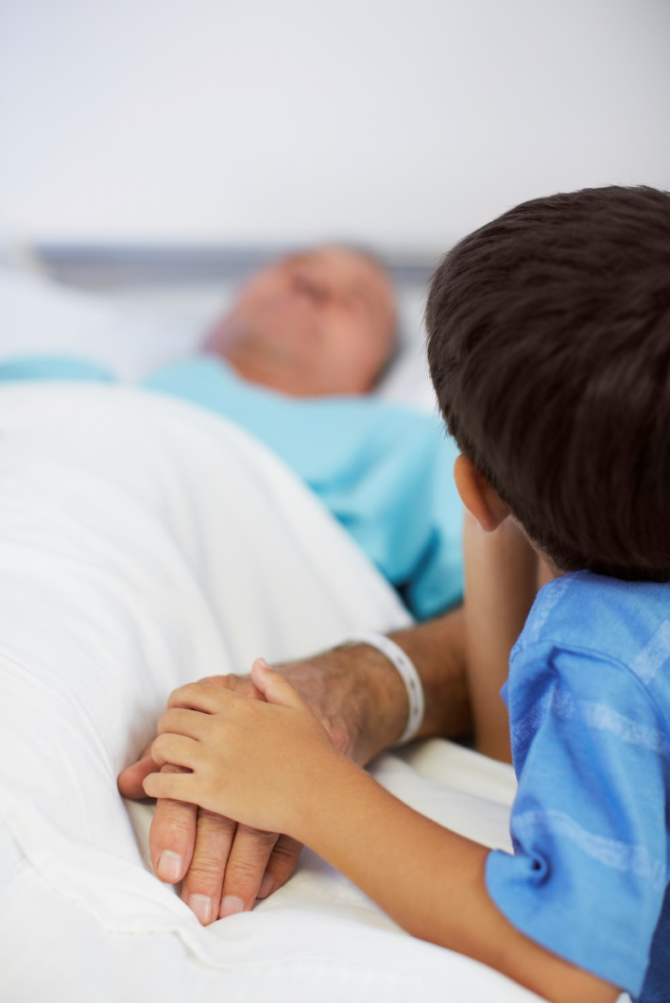
The End of Life
Euthanasia is a direct action, or deliberate lack of action, that causes death.
The term applies when a person is disabled, sick, or dying.
Hastening death can never be a truly moral choice.
© Squaredpixels / iStockphoto.com
Notes:
Emphasize that euthanasia is a procedure purposely causing death; when a patient is dying and death is inevitable and immanent, it is necessary to weigh the benefits and burden of any treatment.
This slide corresponds to content in article 49, “The Inherent Dignity of All Human Life,” in the student book.

